Slide 1
Intro to Python and IDEs

Slide 2
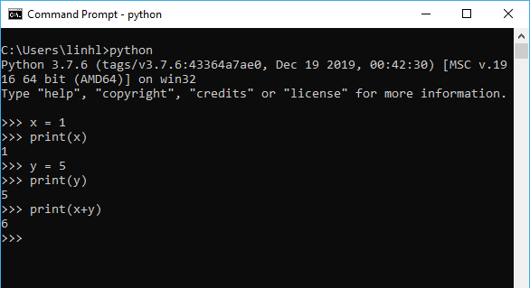
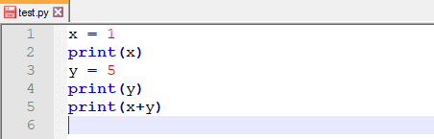
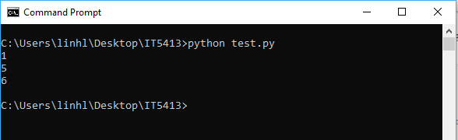

Python
An interpreted, object-oriented, high-level programming language with dynamic semantics
Have interactive mode and script mode
Interactive mode allows us to run Python statements separately
Script mode executes the whole file
Assuming you have a $test.py$ file storing Python scripts, the whole file can be executed in Python script mode
Python interactive mode

Slide 3
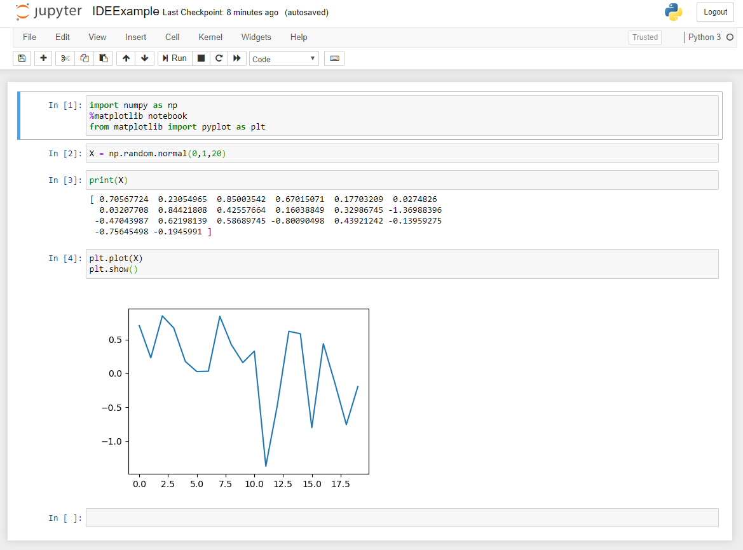
Jupyter Notebook
An Interactive Development Environment (IDE) for Python
Fits very nicely with data analytical tasks

Slide 4
Installing Python

Slide 5
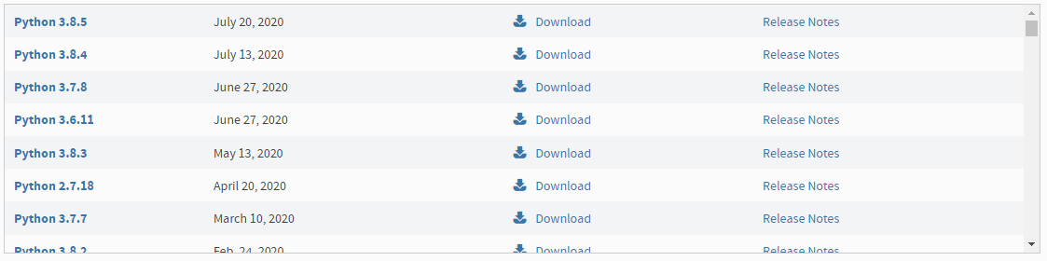
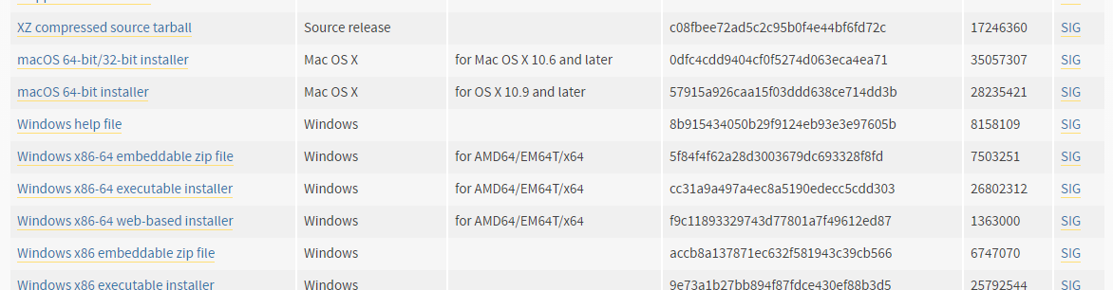
Downloading Python
You can download Python from https://www.python.org/downloads/
Make sure to download Python 3, version like 3.7, 3.8… do not matter too much
Click on Download to be navigate to the download page
Pick the version that fits your system. I will use the executable installer for Windows

Slide 6
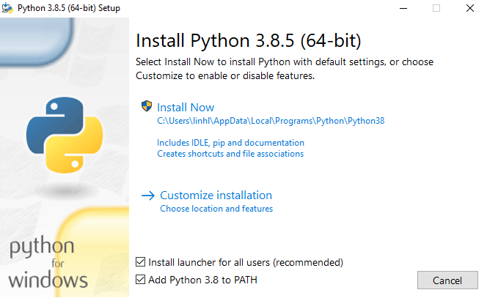
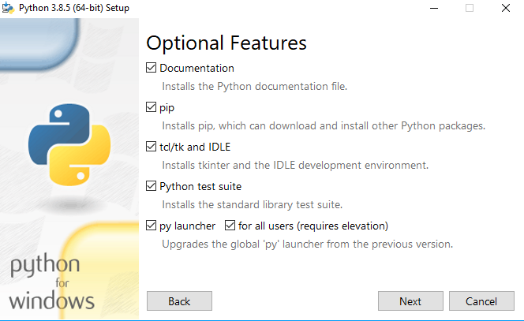
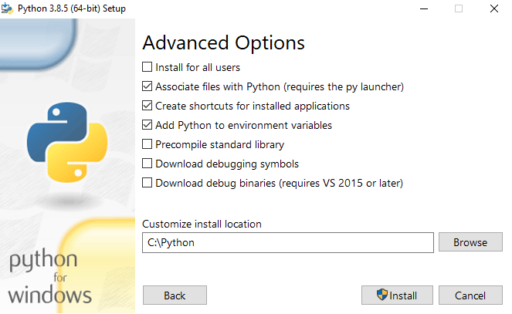

Installing Python
When first launching the installer, make sure “Add Python 3.x to PATH” is selected
Jupyter Notebook may not be able to start if you install Python in the default path. You can change the installation path by first choosing $→ Customize Installation$
Make sure pip is selected in Optional Features
I install Python directly in my C drive (in a folder named Python)

Slide 7
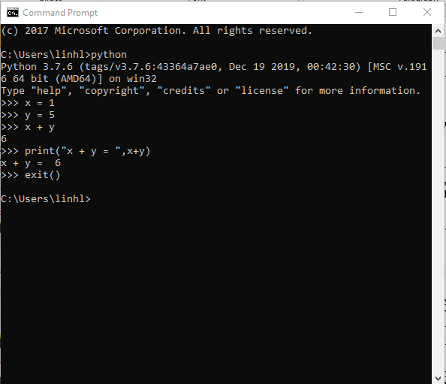
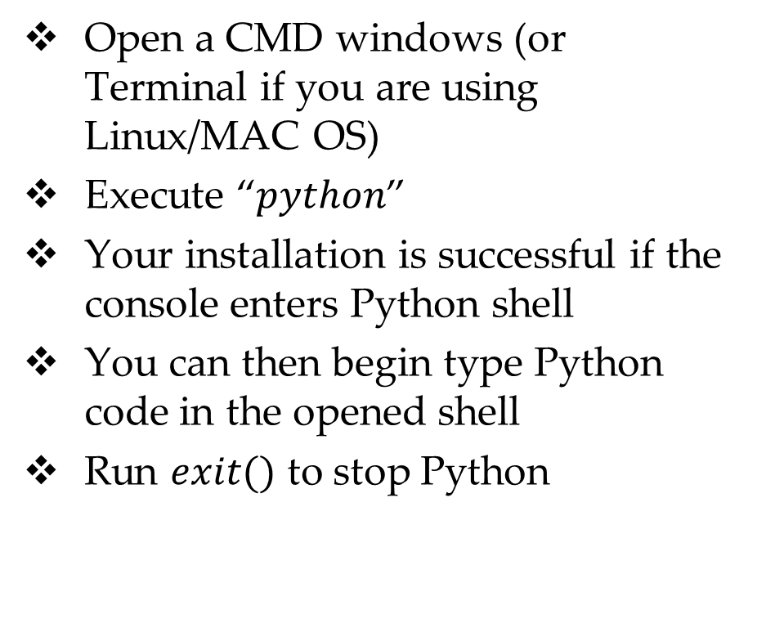
Testing Your Installation
Open a CMD windows (or Terminal if you are using Linux/MAC OS)
Execute “$python$”
Your installation is successful if the console enters Python shell
You can then begin type Python code in the opened shell
Run $exit()$ to stop Python

Slide 8
Python Packages
Base Python comes with a limited set of functionalities
For data analytical tasks, we will need to install additional libraries or packages

Slide 9
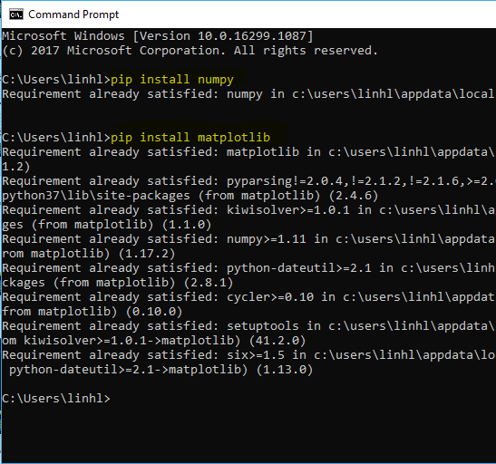
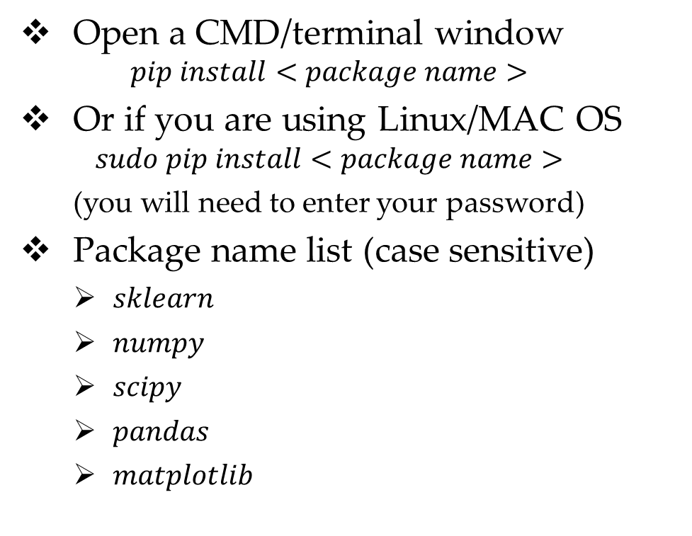
Package Installation
Open a CMD/terminal window
$$pip install<package name>$$
Or if you are using Linux/MAC OS
$$sudo pip install<package name>$$
(you will need to enter your password)
Package name list (case sensitive)
$sklearn$
$numpy$
$scipy$
$pandas$
$matplotlib$

Slide 10
Required Python Package Usages
Scikit-learn: machine learning
SciPy: scientific computation
Pandas: Data Analysis
matplotlib: graphing and visualization
NumPy: vectorized mathematical functions
Notes:
NumPy: Adds Python support for large, multi-dimensional arrays and matrices, along with a large library of high-level mathematical functions to operate on these arrays.
SciPy: provides a large menu of libraries for scientific computation, such as integration, interpolation, signal processing, linear algebra, statistics, etc.
matplotlib library for graphing and visualization
Pandas: offers data structures and operations for manipulating numerical tables and time series.
Scikit-learn: is a collection of advanced machine-learning algorithms for Python

Slide 11
Basic Tutorial for Jupyter Notebook

Slide 12
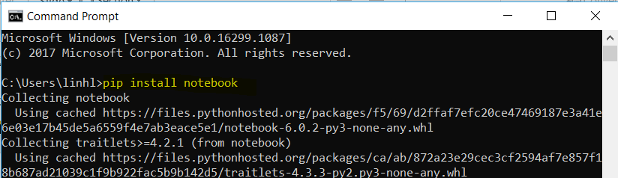
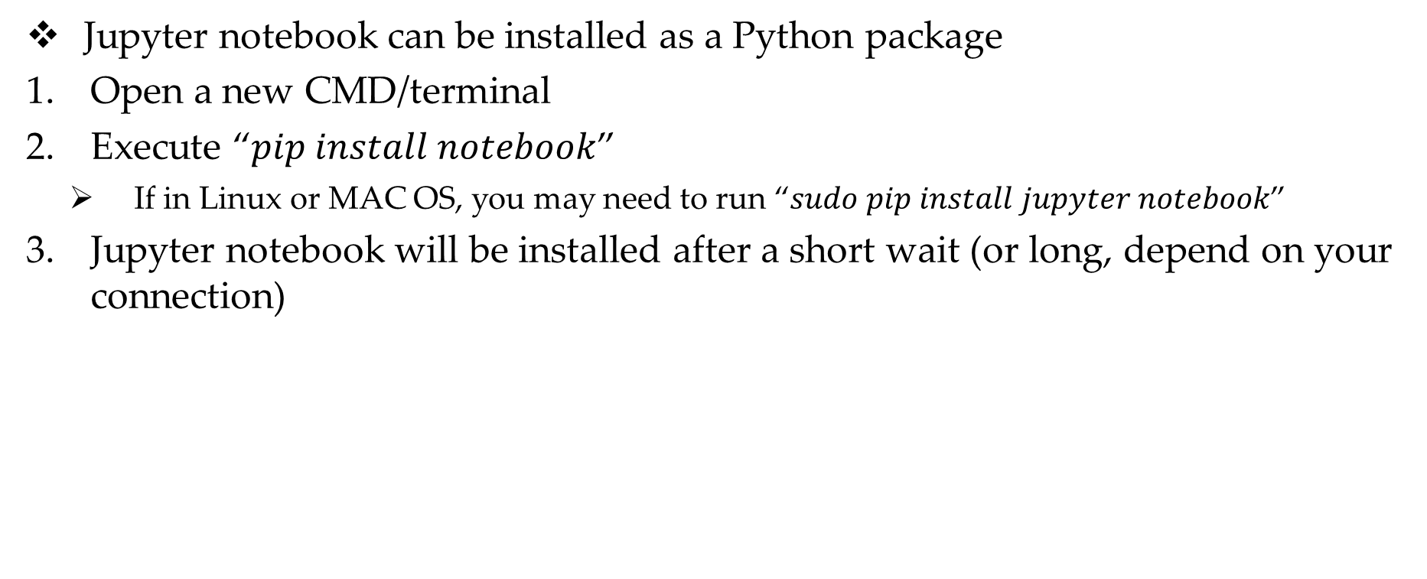
Installing Jupyter Notebook
Jupyter notebook can be installed as a Python package
Open a new CMD/terminal
Execute “$pip install notebook$”
If in Linux or MAC OS, you may need to run “$sudo pip install jupyter notebook$”
Jupyter notebook will be installed after a short wait (or long, depend on your connection)

Slide 13
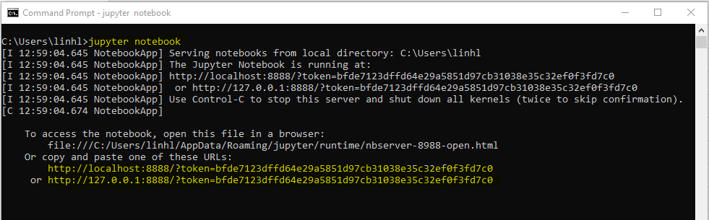

Starting Jupyter Notebook
Open a CMD/Terminal windows
Execute “$jupyter notebook$”
Jupyter notebook will be opened in your default Internet browser. If it is not opened automatically, you can copy the URL that shows up and paste it to your browser
Note that even though you work with Jupyter Notebook through your web browser, it does not require internet connection (though you do need internet to install Jupyter)
To stop Jupyter, press the combination $Ctrl+C$

Slide 14
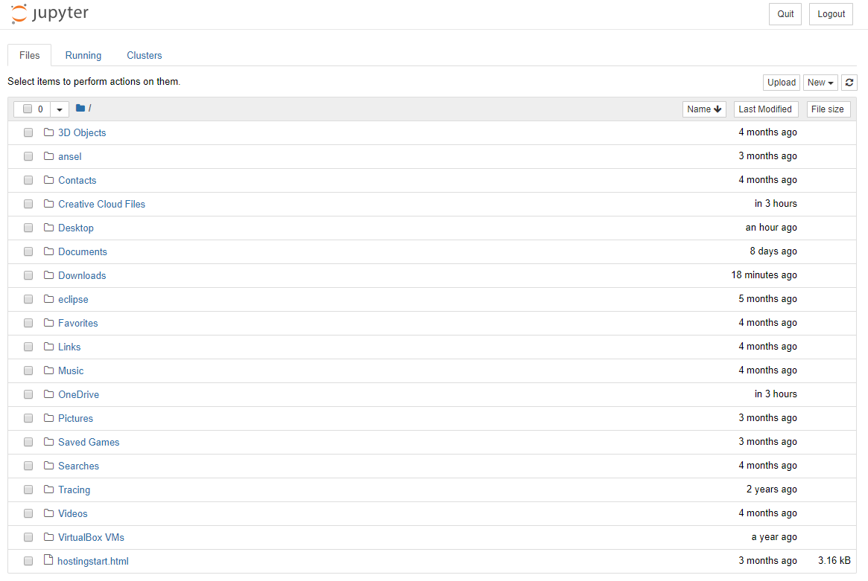
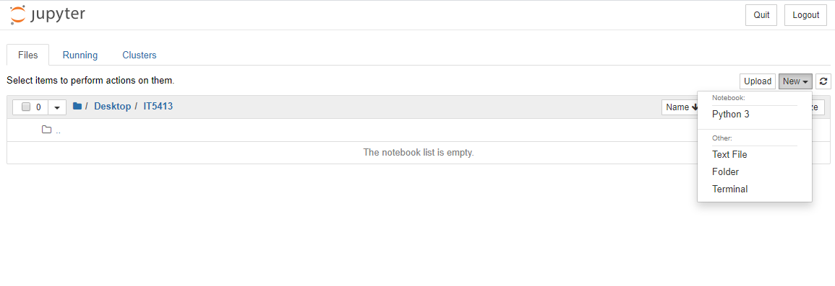
Jupyter Notebook IDE
When first opened, Jupyter will show a directory tree from your home folder
You can navigate to a folder of interest, then begin creating new files/notebooks/folders
Create a new Python 3 Notebook to begin programming ☺

Slide 15
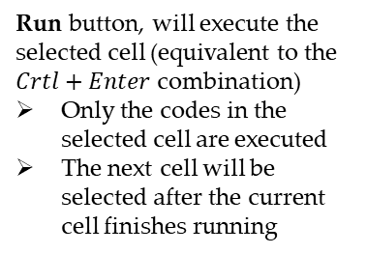
Basic Notebook Interface
Options for kernel (your current notebook/session). You can choose to stop, restart… the current session
Stop button, used to stop a running cell
Options for editing cells. You can choose to add/remove/insert cells…
Run button, will execute the selected cell (equivalent to the $Crtl+Enter$ combination)
Only the codes in the selected cell are executed
The next cell will be selected after the current cell finishes running
An input cell where you type your code. Cell that is being selected is highlighted
Output of an executed cell is shown right below it (if the cell generates any output)
The output of a cell is preserved unless you run it again
Error messages will be shown here too

Slide 16
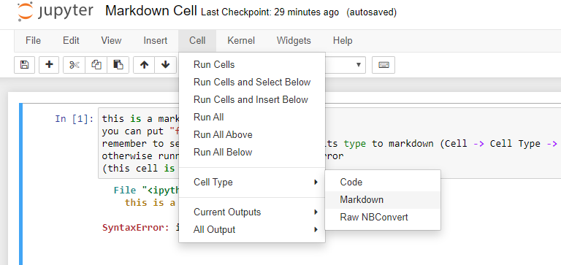
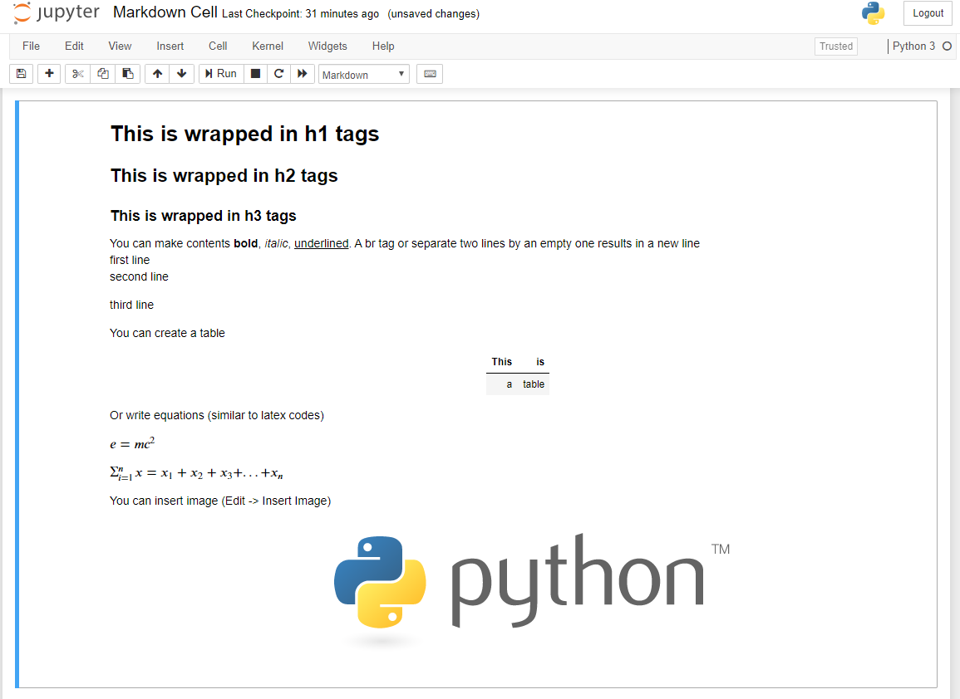

Markdown Cells
You can change a cell type to markdown for better presentations, descriptions, or explanations throughout your code
Markdown cells can be formatted with HTML and latex code
Running a markdown cell show its processed HTML format
Double click on a formatted markdown cell and you can continue editing it
Please see the $markdown_cell_intro$ notebook on D2L for example

Slide 17
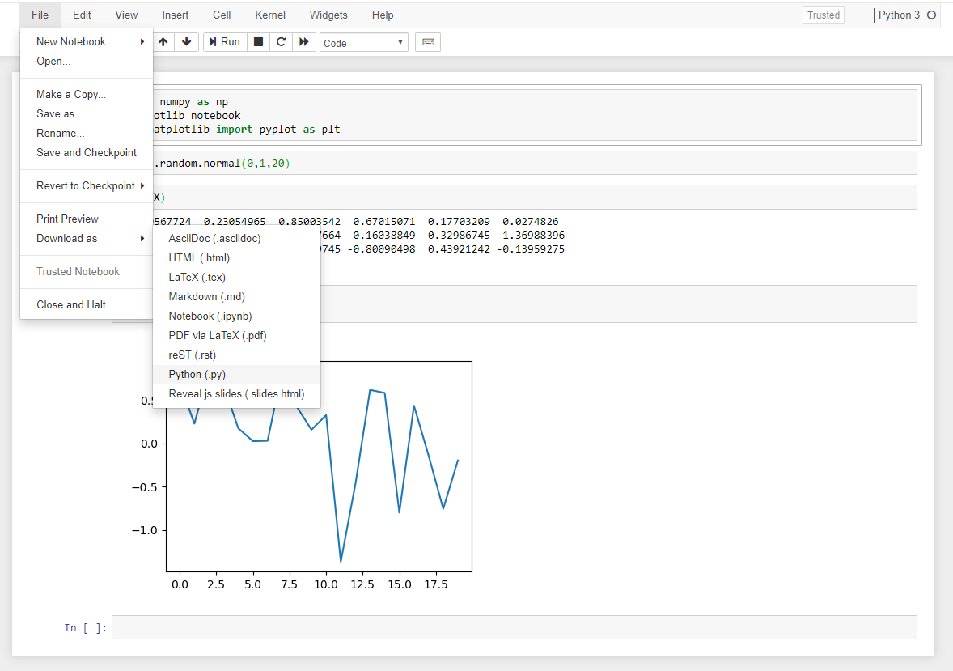
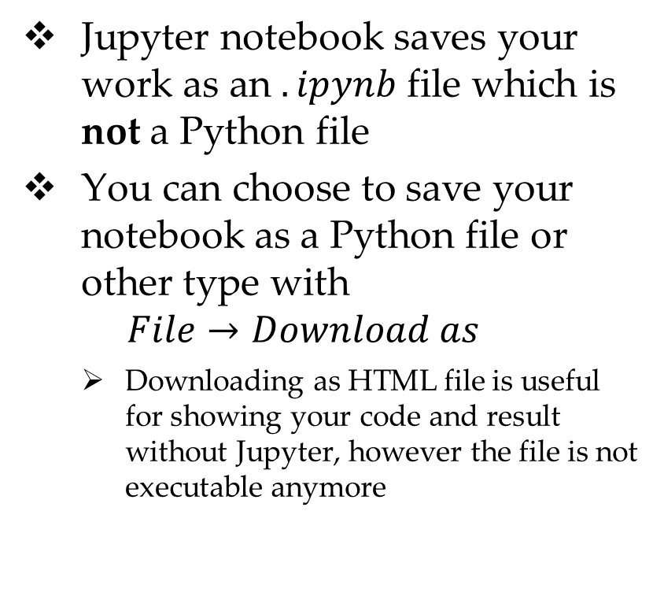
Saving Your Notebook
Jupyter notebook saves your work as an $.ipynb$ file which is not a Python file
You can choose to save your notebook as a Python file or other type with
$$File→Download as$$
Downloading as HTML file is useful for showing your code and result without Jupyter, however the file is not executable anymore

Slide 18
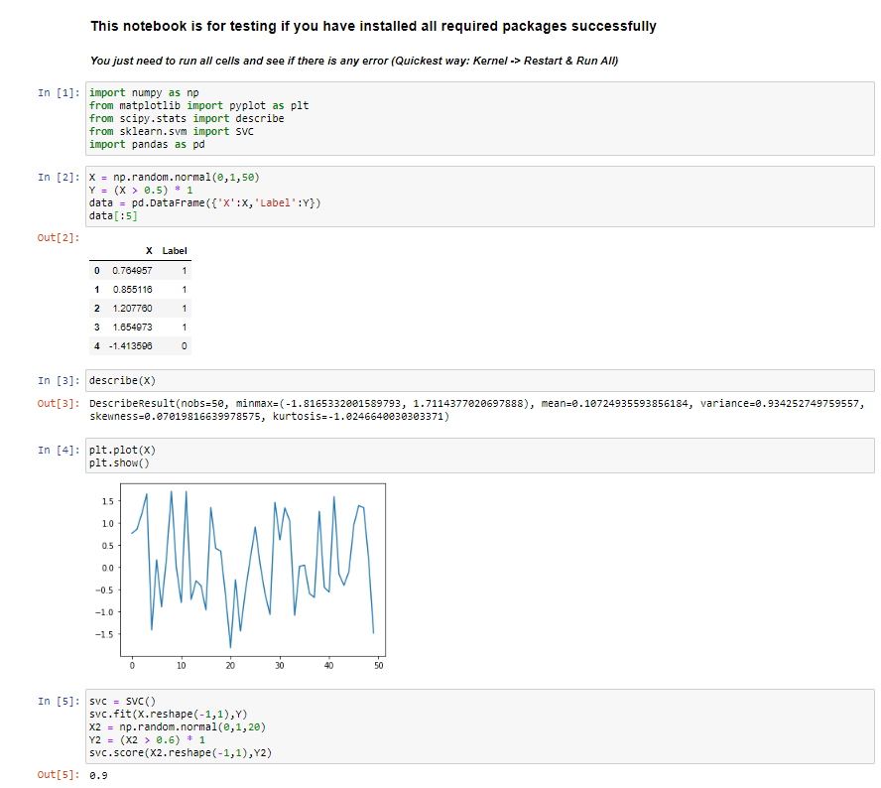
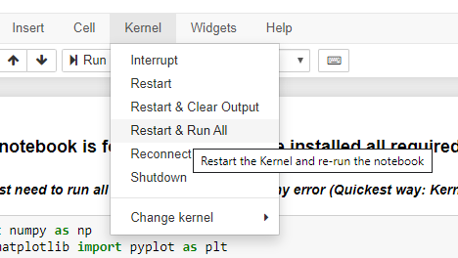
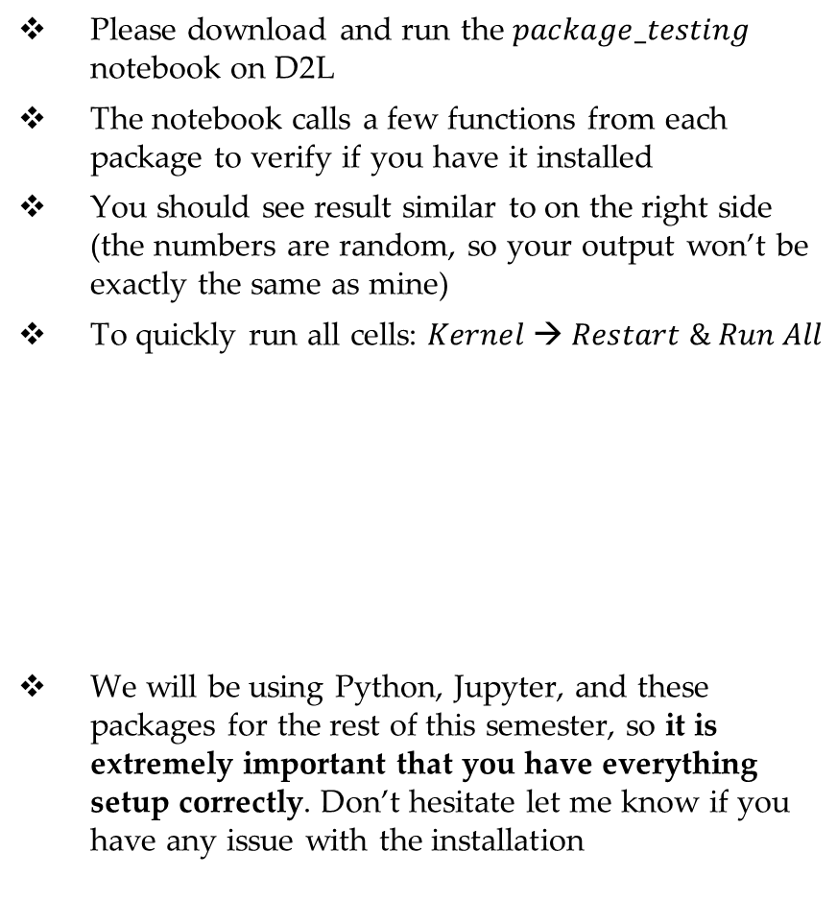
Testing Your Package Installation
Please download and run the $package_testing$ notebook on D2L
The notebook calls a few functions from each package to verify if you have it installed
You should see result similar to on the right side (the numbers are random, so your output won’t be exactly the same as mine)
To quickly run all cells: $Kernel → Restart \& Run All$
We will be using Python, Jupyter, and these packages for the rest of this semester, so it is extremely important that you have everything setup correctly. Don’t hesitate let me know if you have any issue with the installation

Slide 19
Basic Python Programming

Slide 20
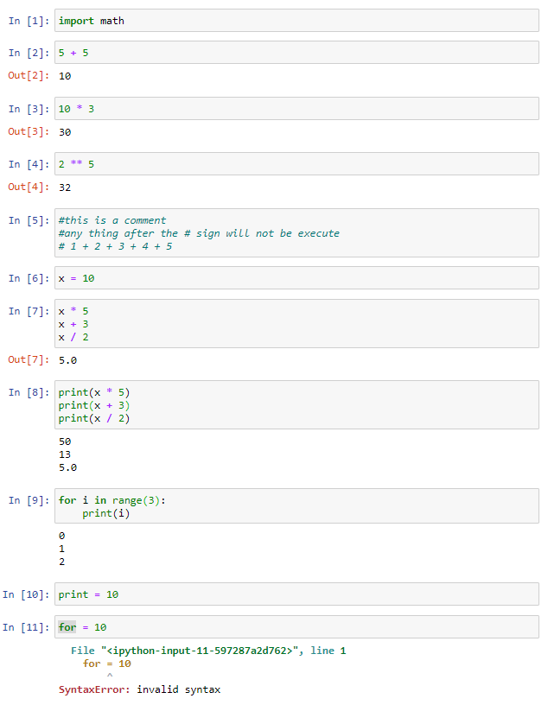
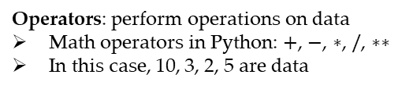



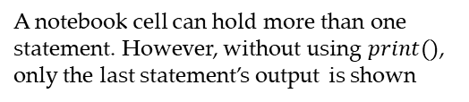
Basic Components of the Python Language
Keywords: predefined words that execute certain instructions
In this case, the import keyword instructs the interpreter to load the package math
Operators: perform operations on data
Math operators in Python: $+$, $−$, $∗$, $/$, $∗∗$
In this case, 10, 3, 2, 5 are data
Statement: a single, complete, instruction that the interpreter can execute
In this case, the interpreter is instructed to compute and show the result of 5 + 5
Comments: descriptive notes put in the script so that the code is more readable. Comments are ignored by the interpreter
Comments in Python begin with a #
Are also useful for error checking – you can comment out some statements to check others
Variables: symbolic names that refer to an object
Variables are assigned values using the $=$ operator
In this case, the variable $x$ is assigned a value of the integer number 10
A notebook cell can hold more than one statement. However, without using $print()$, only the last statement’s output is shown
Not all statements are one-line. In this case, the two lines make up a single for statement. Note that $print(i)$ is also a statement in the for statement.
for is another keyword
print and range are built-in functions’ names (hence the highlighting)
The difference is that names can be reassigned with new values, keywords cannot
You need to use $print()$ to show outputs of all statements
Errors: issues that prevent the scripts from being executed
Caused by different reasons. In this case, assigning value to a keyword is considered a syntax error
In general, the interpreter will always try to point to the position of the error and show the error message

Slide 21
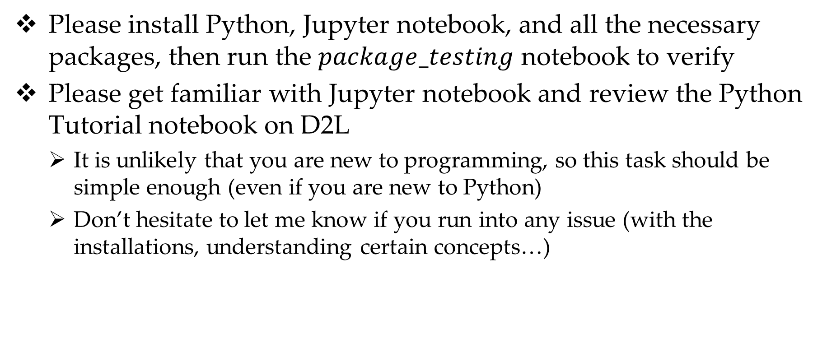
This Week Tasks
Please install Python, Jupyter notebook, and all the necessary packages, then run the $package_testing$ notebook to verify
Please get familiar with Jupyter notebook and review the Python Tutorial notebook on D2L
It is unlikely that you are new to programming, so this task should be simple enough (even if you are new to Python)
Don’t hesitate to let me know if you run into any issue (with the installations, understanding certain concepts…)

